Slide 1
Information Diversity Improves NLP Solutions
Meng Jiang 蒋 朦
Department of Computer Science and Engineering
University of Notre Dame

Slide 2

Information Diversity Improves NLP Solutions
Commonsense Reasoning: Diverse paths on commonsense knowledge graphs improve explanation generation.
Knowledge-intensive NLP: Diverse contexts improve knowledge augmentation and open-domain question answering.
Information Retrieval: Diverse expanded queries, covering diverse user intents, improve document retrieval.

Slide 3
Information Diversity Improves NLP Solutions
Commonsense Reasoning: Diverse paths on commonsense knowledge graphs improve explanation generation.
Knowledge-intensive NLP: Diverse contexts improve knowledge augmentation and open-domain question answering.
Information Retrieval: Diverse expanded queries, covering diverse user intents, improve document retrieval.

Slide 4




Diversifying Content Generation for Commonsense Reasoning with Mixture of Knowledge Graph Experts
Dublin
The 60th Annual Meeting of the Association for Computational Linguistics (ACL)
Wenhao Yu, Chenguang Zhu, Lianhui Qin, Zhihan Zhang, Tong Zhao, Meng Jiang

Slide 5
Multi-choice Commonsense Question Answering
Commonsense Fact Verification
Where can I stand on a river to see water falling without getting wet?
A pound of cotton has the same weight as a pound of steel.
A) waterfall
B) bridge
C) valley
D) stream
E) bottom
True
False
Datasets:
OpenBookQA: Clark et al. arxiv 2018. (5,957 questions)
CommonsenseQA 1.0： Talmor et al. NAACL 2019. (12,102)
Evaluation: Accuracy.
Datasets:
CommonsenseQA 2.0: Talmor et al. (14,343 assertions)
CREAK： Onoe et al. NeurIPS 2021 Benchmark Track. (13,000)
Evaluation: Accuracy.
Constrained Commonsense Generation
Counterfactual Explanation Generation
Constraints: dog, frisbee, catch, throw
I am hungry for water.
Description: A girl throws a frisbee and her dog catches it.
Outputs:
1) Water is used to quench thirsty.
2) You are thirsty for water, not hungry.
3) Water is not food.
Datasets:
CommonGen: Lin et al. Findings of EMNLP 2020. (79,000+ commonsense descriptions)
Evaluation: SPICE, BLEU-4, ROUGE-L, CIDEr.
Datasets:
ComVE: Wang et al. SemEval-2020 Task 4 (11,997 examples)
Evaluation: SPICE, BLEU-4, ROUGE-L, CIDEr.

Slide 6
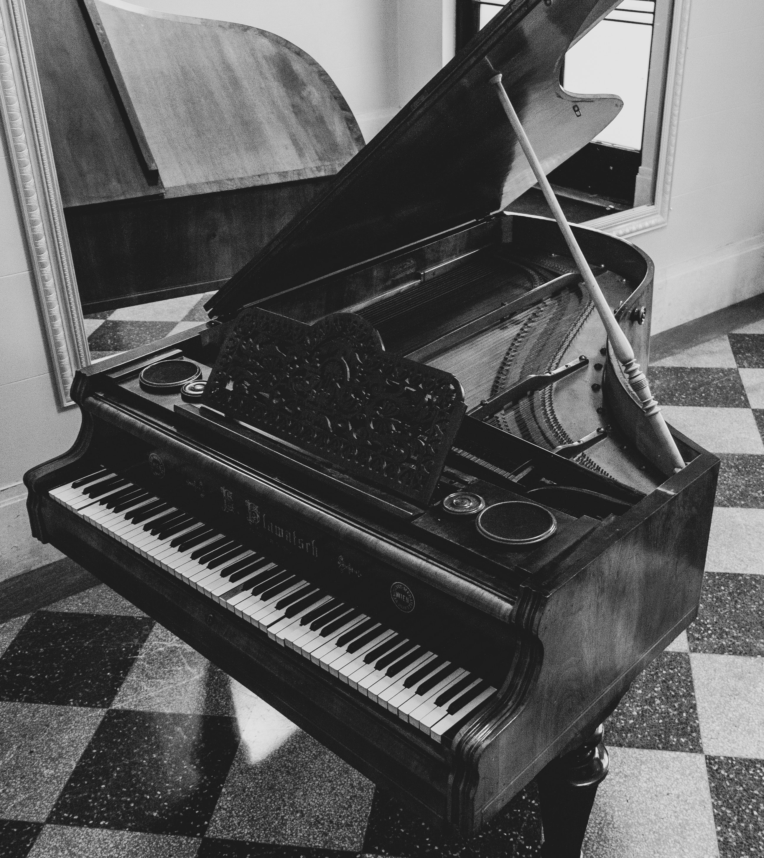
Commonsense Reasoning
Explaining counterfactual statements
Input:
Piano is a kind of sport. This is False because ___________________
Annotators 1 and 4:
you can produce music when pressing keys on the piano, so it is an instrument.
Annotators 3 and 5:
piano is a musical instrument used in songs to produce different musical tones.
Annotator 2:
piano is a kind of art form.

Slide 7
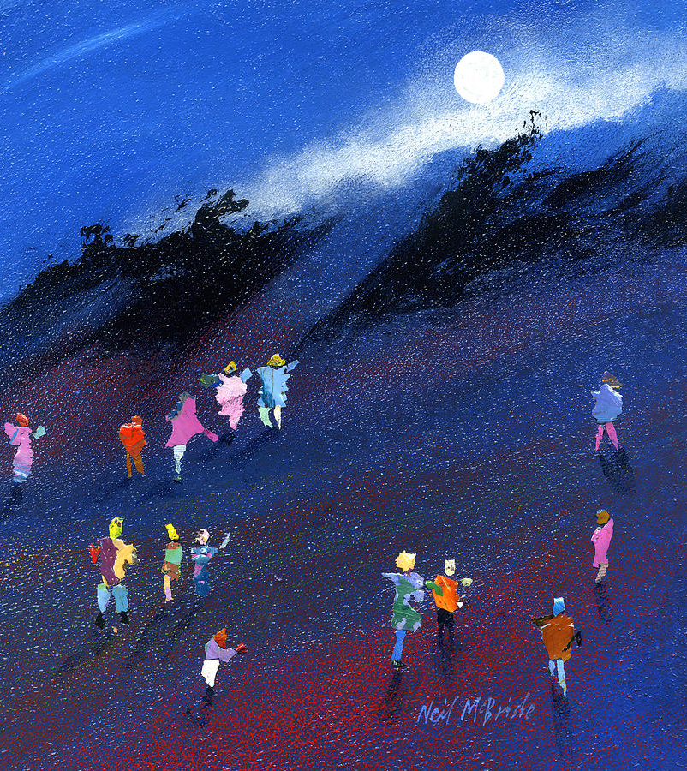
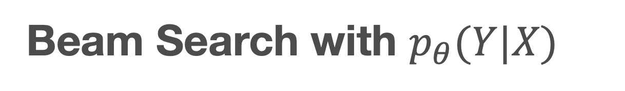
Beam Search with $p_{θ}(Y|X)$
Greedy algorithm
piano
is
a
an
not
musical
a
instrument
sport
.

Slide 8
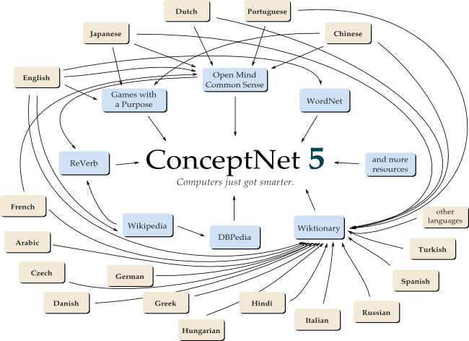
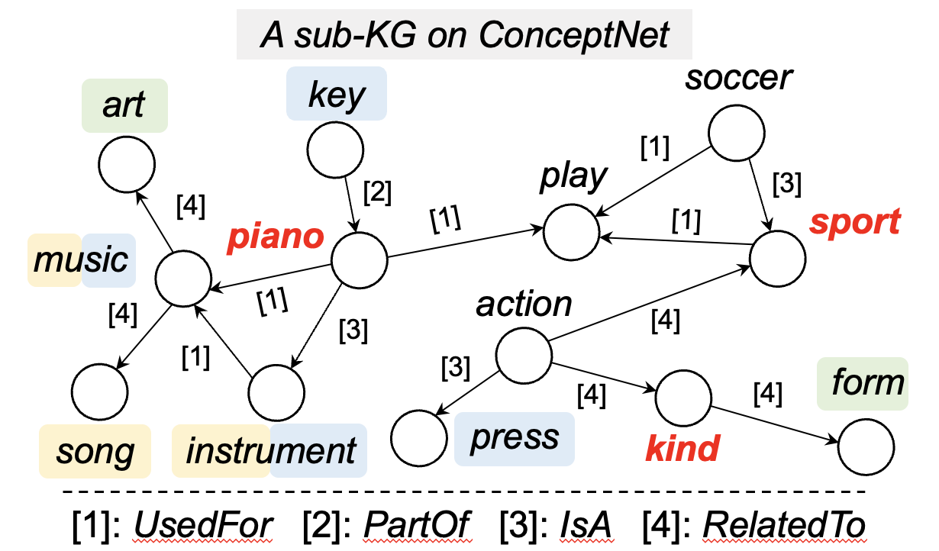
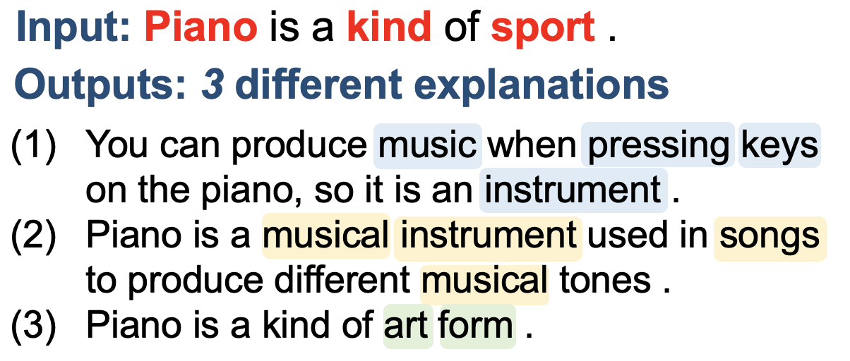
Enhancing GENERATION DIVERSITY

Slide 9
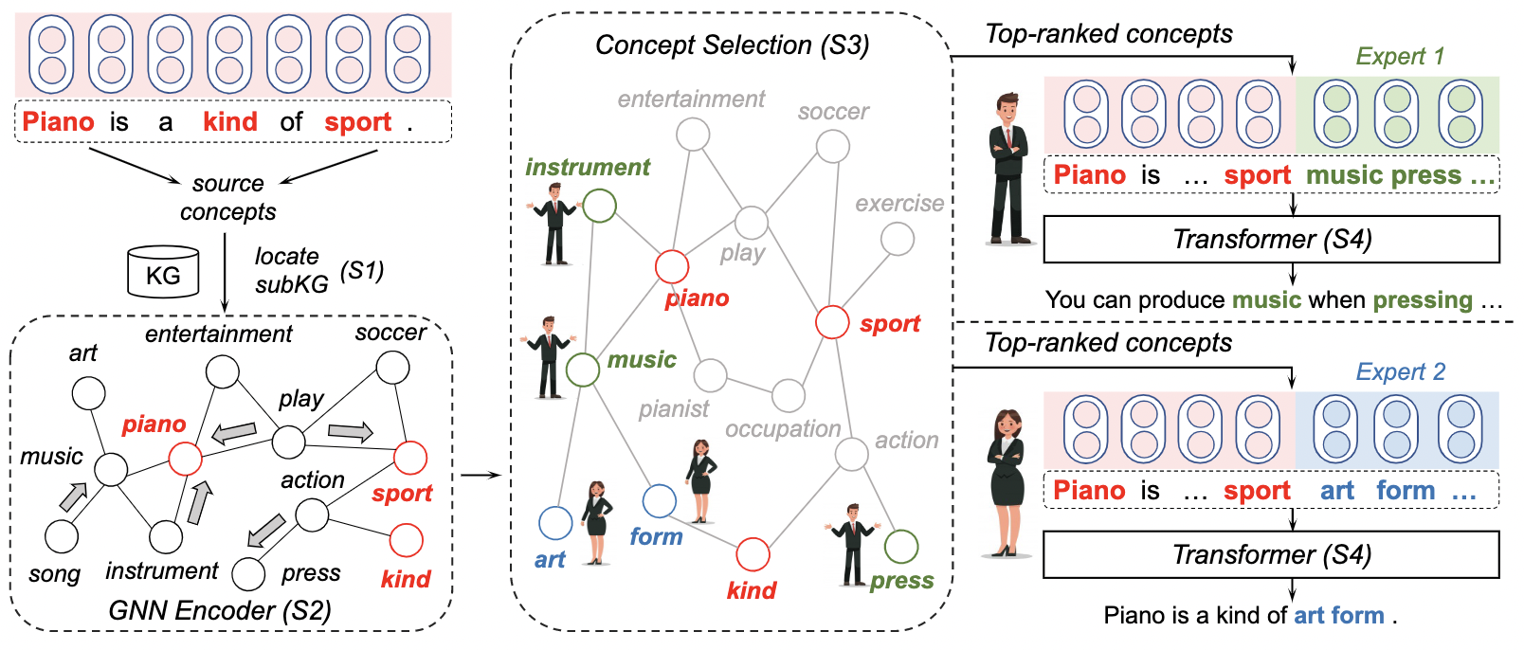
Mixture of Knowledge Graph Experts (MoKGE)

Slide 10

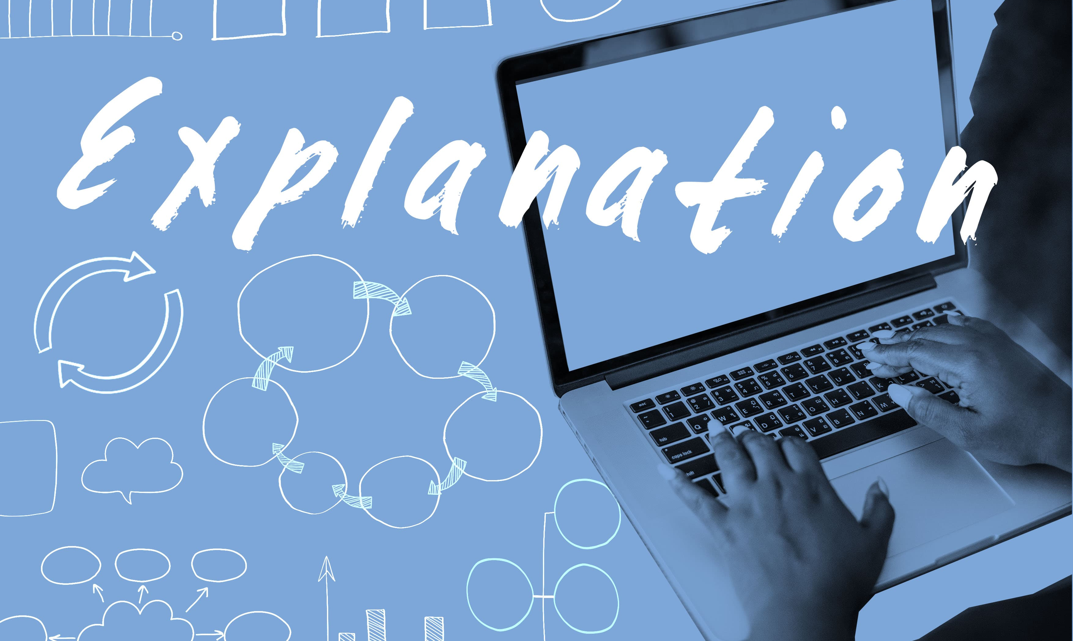
Results: ComVE (SemEval 2020: Task 4)
 | SelfBERT (↓) | Distinct-2 (↑) | R-L (↑)
Truncated samp. | 61.39 | 34.80 | 17.48
Nucleus samp. | 63.43 | 34.17 | 17.68
MoKGE | 30.93 | 48.44 | 19.13
Human | 12.36 | 63.02 | 100.0
Human evaluation:
 | Diversity | Quality
Truncated samp. | 2.15±0.76 | 2.22±1.01
Nucleus samp. | 2.03±0.73 | 2.29±1.03
MoKGE | 2.63±0.51 | 2.10±0.99
Human | 2.60±0.59 | 3.00

Slide 11
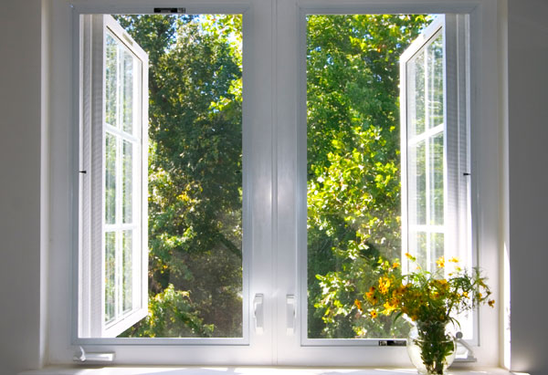
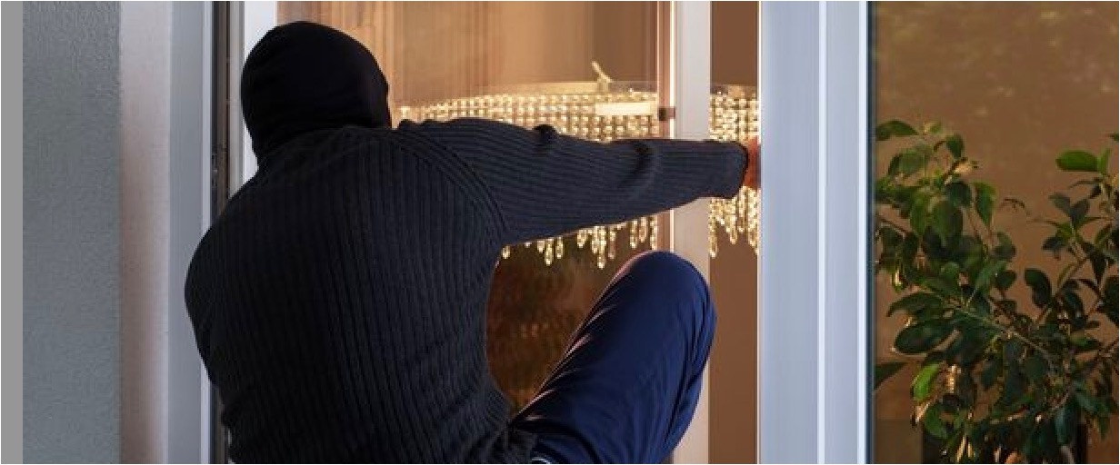
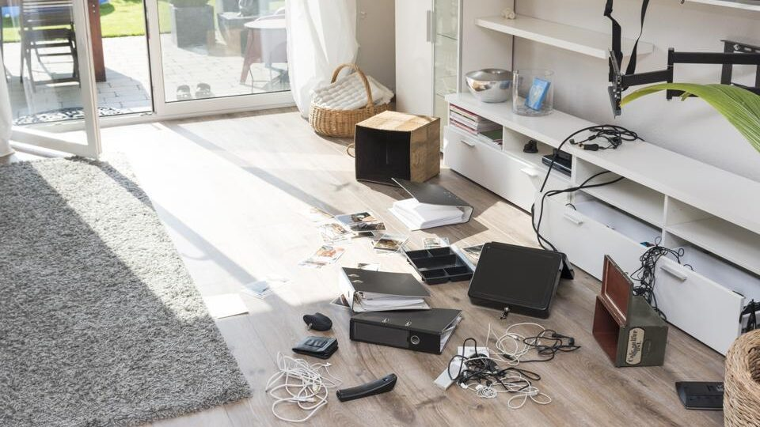
Results: α-NLG (Abductive Commonsense Reasoning)
Cleaned house
Went to work
Leaved windows open
 | SelfBERT (↓) | Distinct-2 (↑) | R-L (↑)
Truncated samp. | 52.11 | 30.08 | 38.98
Nucleus samp. | 56.32 | 29.92 | 13.53
MoKGE | 27.40 | 38.15 | 38.82
Human | 10.36 | 53.57 | 100.0
?
Human evaluation:
 | Diversity | Quality
Truncated samp. | 2.31±0.76 | 2.63±0.77
Nucleus samp. | 2.39±0.73 | 2.67±0.72
MoKGE | 2.66±0.51 | 2.57±0.71
Human | 2.71±0.57 | 3.00
Back home
Found a mess

Slide 12

Information Diversity Improves NLP Solutions
Commonsense Reasoning: Diverse paths on commonsense knowledge graphs improve explanation generation.
Knowledge-intensive NLP: Diverse contexts improve knowledge augmentation and open-domain question answering.
Information Retrieval: Diverse expanded queries, covering diverse user intents, improve document retrieval.

Slide 13
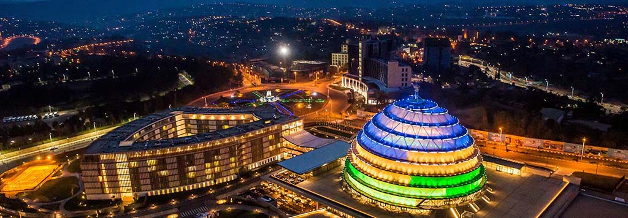
Generate rather than Retrieve: Large Language Models are Strong Context Generators
Kigali Rwanda
The 2023 International Conference on Learning Representations
Wenhao Yu, Dan Iter, Shuohang Wang, Yichong Xu, Mingxuan Ju, Soumya Sanyal, Chenguang Zhu, Michael Zeng, Meng Jiang

Slide 14
Open-Domain Question Answering
LLMs in Open-Book Framework
Wikipedia
GPT-3
Retriever
Retrieved passages
Generated passages
Question
Answer
Question
Answer
Reader
Reader

Slide 15

Why not use GPT-3 to directly generate the answer?
Who got the first Nobel prize in physics?
Who got the first Nobel prize in physics?
“Generate a background document to answer
the given question [Q]:”
“Question: [Q] Answer:”
Zero-Shot Open-Domain Question Answering
The first Nobel Prize in Physics was awarded in 1901 to Wilhelm Conrad Rontgen in recognition of the extraordinary services he has rendered by the discovery of the remarkable rays subsequently named after him
GPT-3
(175 Billion parameters)
GPT-3
(Exact Match) | Web Questions | Natural Questions | TriviaQA
Ours | 24.8 | 28.2 | 59.3
PaLM (540B) | 19.0 | 24.7 | 56.7
InstructGPT | 18.6 | 20.9 | 52.6
🏆
“Question: [Q]
Passage: [P]
Answer: ”
GPT-3
Albert Einstein.
Wilhelm Conrad Rontgen
GPT-3 is not a reader specialist. Fusion-in-Decoder (FiD) is the state-of-the-art Reader. Supervised Learning (with FiD) performs much better than Zero-Shot.
Izacard and Grave. Leveraging Passage Retrieval with Generative Models for Open Domain Question Answering. EACL 2021.

Slide 16
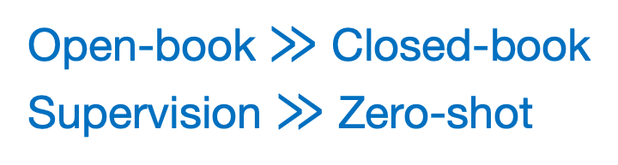
GenRead: Supervised Learning
“Many shots”: Training QA specialists
WebQ | NaturalQ | TriviaQA
56.2 | 54.0 | 74.3
55.4 | - | 72.6
54.5 | 45.6 | 71.6
50.8 | 50.1 | 66.3
53.6 | 45.0 | 65.4
46.5 | 42.8 | 65.4
24.8 | 28.2 | 59.3
Merged | Reader
GPT-3 + DPR | FiD
🏆
Passages complementarity
Ours:
Generator | Reader
Codex | FiD
GPT-3 | FiD
Ours:
LLMs are effective for
knowledge augmentation
Ours:
Retriever | Reader
DPR | FiD
Google API | FiD
BM25 | FiD
State-of-the-art:
Open-book $≫$ Closed-book
Supervision $≫$ Zero-shot
Generator (closed-book)
GPT-3 (zero-shot)

Slide 17
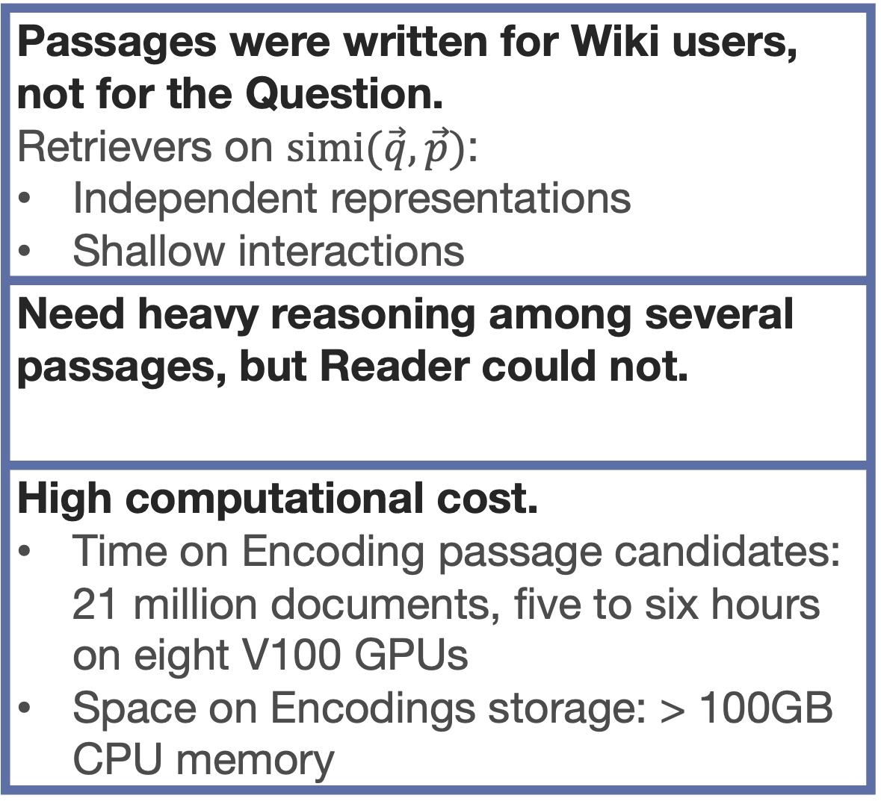
Retrieved Passages vs Generated Passages
Passages were written for Wiki users, not for the Question. Retrievers on $simi(\vec{q},\vec{p})$: Independent representations Shallow interactions
Need heavy reasoning among several passages, but Reader could not.
High computational cost. Time on Encoding passage candidates: 21 million documents, five to six hours on eight V100 GPUs Space on Encodings storage: > 100GB CPU memory
LLMs understand every word in Question to create Passages. GPT-3 and its family models: Highly expressive with Cross-attention
LLMs have shown reasoning abilities Learned from large pre-trained corpora Complex reasoning at a certain level
Efficiency Just “look up” world knowledge stored in the model parameters
IF DOMAIN MATCHED AND API AVAILABLE The information needed in target task (e.g., QA) was collected when pre-training LLMs.
!

Slide 18
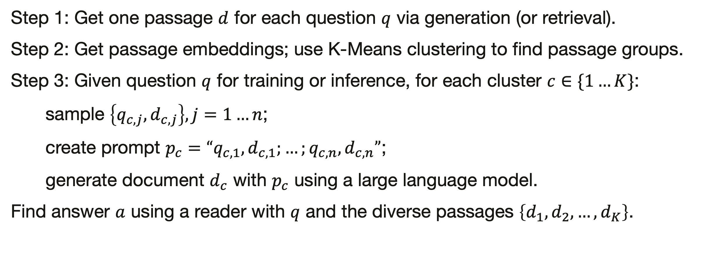
Diversifying Generated Passages
Clustering, then Prompting with Different Clusters
Step 1: Get one passage $d$ for each question $q$ via generation (or retrieval).
Step 2: Get passage embeddings; use K-Means clustering to find passage groups.
Step 3: Given question $q$ for training or inference, for each cluster $c∈\{1…K\}$:
sample $\left\{q_{c,j},d_{c,j}\right\},j=1…n$;
create prompt $p_{c}=“q_{c,1},d_{c,1};…;q_{c,n},d_{c,n}”$;
generate document $d_{c}$ with $p_{c}$ using a large language model.
Find answer $a$ using a reader with $q$ and the diverse passages $\left\{d_{1},d_{2},…,d_{K}\right\}$.

Slide 19
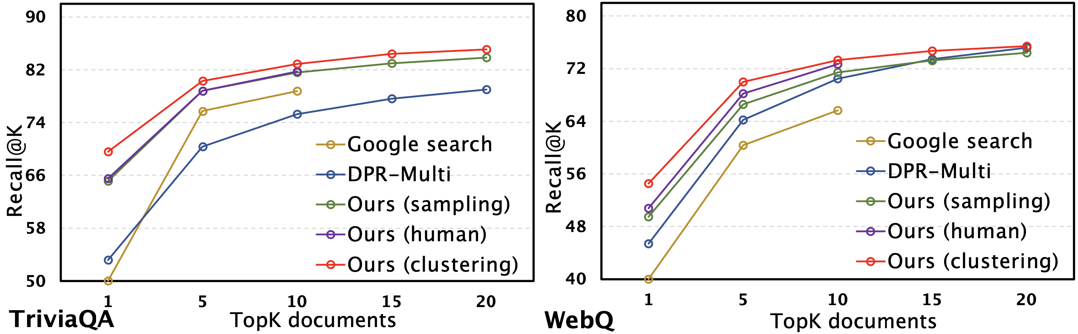
Impact of Diverse Passages
Answer accuracy:
 |  | WebQ | NaturalQ | TriviaQA | Avg.
FiD-l (770M) | sampling | 51.5 | 40.3 | 67.8 | 53.2
 | clustering | 53.3 | 43.5 | 70.2 | 55.6
FiD-xl (3B) | sampling | 52.6 | 42.6 | 69.6 | 54.9
 | clustering | 54.4 | 45.6 | 71.6 | 57.1
Passage’s answer coverage:

Slide 20
Other Tasks
Fact checking:
 | WebQ | NaturalQ
RAG | 86.3 | 71.1
GenRead (sampling) | 89.0 | 76.3
GenRead (clustering) | 89.6 | 77.8
GenRead (merged) | 91.8 | 78.9
Open-domain dialogue system:
On WoW | (F1) | (ROUGE-L)
RAG | 13.1 | 11.6
GenRead (sampling) | 18.9 | 16.7
GenRead (clustering) | 19.1 | 16.8
GenRead (merged) | 20.1 | 17.9

Slide 21
Surprising Zero-Shot / Few-Shot Performance
Large Language Models are Built-in Auto-regressive Search Engines (ACL-Findings 2023)
GPT-3
GPT-3
Generated URLs
Wikipedia
Passages
90% contain answer
w/o indexing docs
Generated passages
Input
Output
Input
Output
“Question: [Q]. Which [k] URLs would have the answer?”
GPT-3
GPT-3
GenRead
LLM-URL
(Exact Match) | Web Questions | Natural Questions | TriviaQA
LLM-URL (few-shot) | 29.0 | 27.3 | 60.7
LLM-URL (zero-shot) | 28.1 | 26.4 | 60.1
GenRead (zero-shot) | 24.8 | 28.2 | 59.3
PaLM (540B) | 19.0 | 24.7 | 56.7
InstructGPT | 18.6 | 20.9 | 52.6

Slide 22
Information Diversity Improves NLP Solutions
Commonsense Reasoning: Diverse paths on commonsense knowledge graphs improve explanation generation.
Knowledge-intensive NLP: Diverse contexts improve knowledge augmentation and open-domain question answering.
Information Retrieval: Diverse expanded queries, covering diverse user intents, improve document retrieval.

Slide 23
Improving Diversity of Query Expansions in Document Retrieval
Under Review
Hy Dang, Mengxia Yu, Meng Jiang

Slide 24
Motivation: Diverse User Intents
Query
Dioxins Stored in Our Own Fat May Increase Diabetes Risk
Existing work (Q2D):
… dioxins can disrupt the body’s ability to regulate blood sugar levels, leading to insulin resistance and type 2 diabetes…
Ground-truth Documents
… Dioxins are a group of toxic chemicals that are persistent in the environment and can accumulate in the fatty tissues …
… dioxin-induced diabetes to be the ratio of mRNA of glucose transporter 4 (GLUT4) and nuclear transcription factor kappa B (NFκB), … This ratio showed significant correlations to serum dioxin …
… Dioxins can affect insulin sensitivity and glucose metabolism, leading to an increased risk of diabetes.
GLUT4:NFκB Ratio
… Increased Rate of Hospitalization for Diabetes and Residential Proximity of Hazardous there may be an association between environmental exposure to persistent organic pollutants (POPs) and diabetes …
Expected:
POPs and Diabetes
... dioxins, a group of persistent organic pollutants (POPs), are hazardous …
… study that found a correlation between the ratio of mRNA of glucose transporter 4 (GLUT4) and nuclear transcription factor kappa B (NFκB) and serum dioxin residues …
… Insulin resistance and the defective function of pancreatic β-cells can occur several years before the development of type 2 diabetes…
… Studies have shown that exposure to dioxins can lead to insulin resistance …
Insulin Resistance and Diabetes

Slide 25


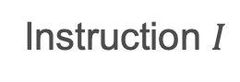
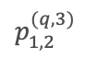
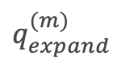
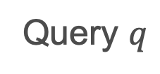
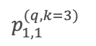
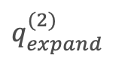
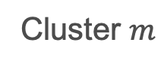
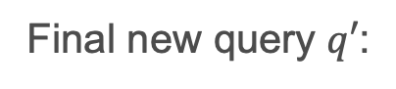
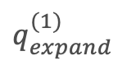
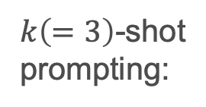

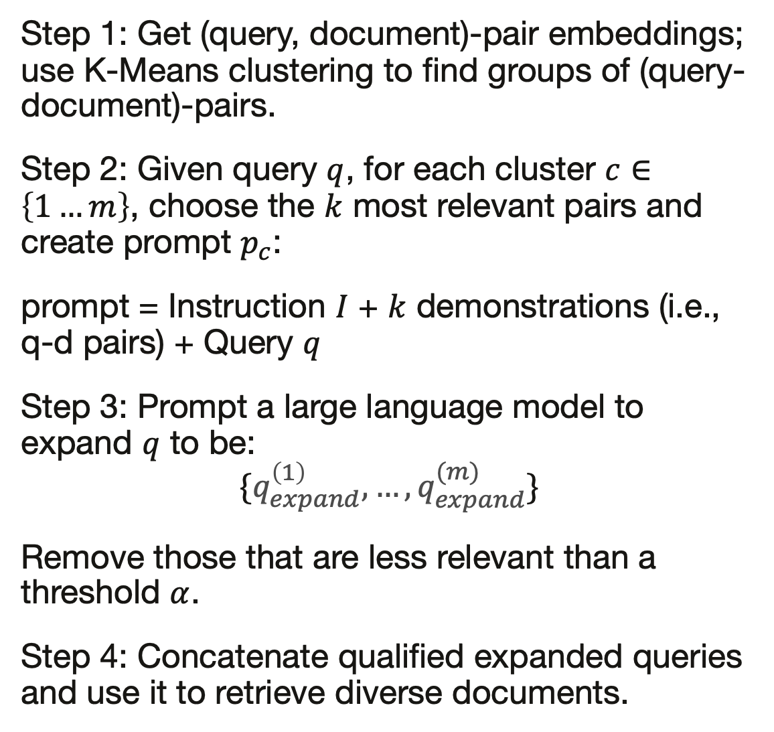
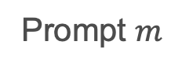
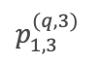
Diversify Demonstrations and Expanded Queries
Step 1: Get (query, document)-pair embeddings; use K-Means clustering to find groups of (query-document)-pairs.
Step 2: Given query $q$, for each cluster $c∈\left\{1…m\right\}$, choose the $k$ most relevant pairs and create prompt $p_{c}$:
prompt = Instruction $I$ + $k$ demonstrations (i.e., q-d pairs) + Query $q$
Step 3: Prompt a large language model to expand $q$ to be:
$$\{q_{expand}^{\left(1\right)},…,q_{expand}^{(m)}\}$$
Remove those that are less relevant than a threshold $α$.
Step 4: Concatenate qualified expanded queries and use it to retrieve diverse documents.
Query $q$
query-document pairs
Embedding space
Cluster $m$
$$p_{1,1}^{(q,k=3)}$$
$$p_{1,2}^{(q,3)}$$
$$p_{1,3}^{(q,3)}$$
Instruction $I$
Cluster 1
Cluster 2
$k\left(=3\right)$-shot
prompting:
Prompt 1
Prompt 2
…
Prompt $m$
Large Language Model $LLM(∙)$
Diverse
expanded queries:
…
$$q_{expand}^{(1)}$$
$$q_{expand}^{(2)}$$
$$q_{expand}^{(m)}$$
Final new query $q′$:
retrieve diverse documents

Slide 26
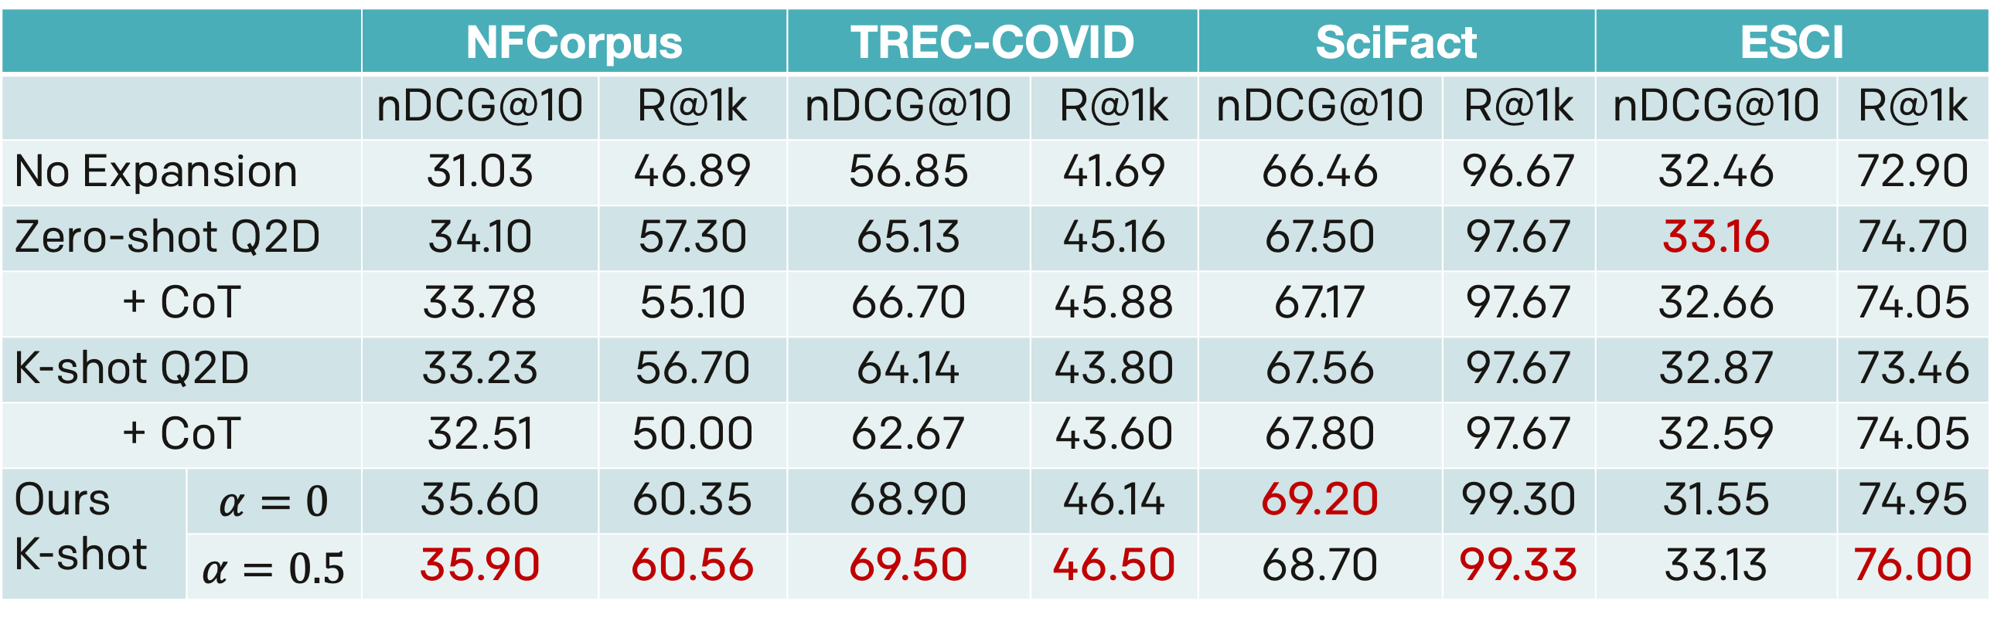
Results
 |  | NFCorpus |  | TREC-COVID |  | SciFact |  | ESCI
 |  | nDCG@10 | R@1k | nDCG@10 | R@1k | nDCG@10 | R@1k | nDCG@10 | R@1k
No Expansion |  | 31.03 | 46.89 | 56.85 | 41.69 | 66.46 | 96.67 | 32.46 | 72.90
Zero-shot Q2D |  | 34.10 | 57.30 | 65.13 | 45.16 | 67.50 | 97.67 | 33.16 | 74.70
+ CoT |  | 33.78 | 55.10 | 66.70 | 45.88 | 67.17 | 97.67 | 32.66 | 74.05
K-shot Q2D |  | 33.23 | 56.70 | 64.14 | 43.80 | 67.56 | 97.67 | 32.87 | 73.46
+ CoT |  | 32.51 | 50.00 | 62.67 | 43.60 | 67.80 | 97.67 | 32.59 | 74.05
Ours K-shot | $$α=0$$ | 35.60 | 60.35 | 68.90 | 46.14 | 69.20 | 99.30 | 31.55 | 74.95
 | $$α=0.5$$ | 35.90 | 60.56 | 69.50 | 46.50 | 68.70 | 99.33 | 33.13 | 76.00

Slide 27
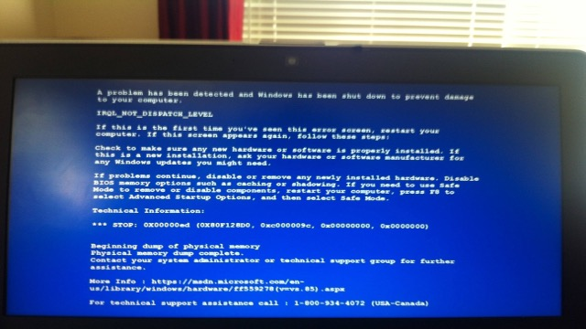





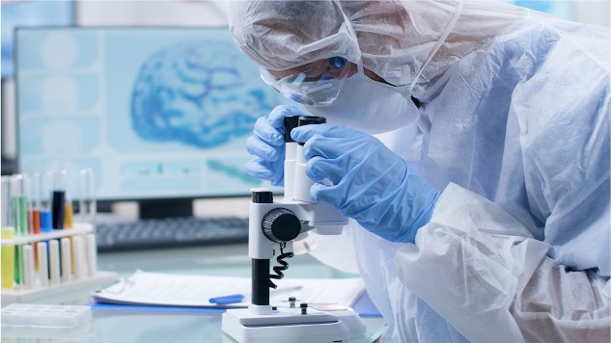

Technical Support
Online Education
Mental Health
Scientific Discovery
CAREER Award

Slide 28
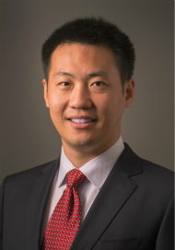
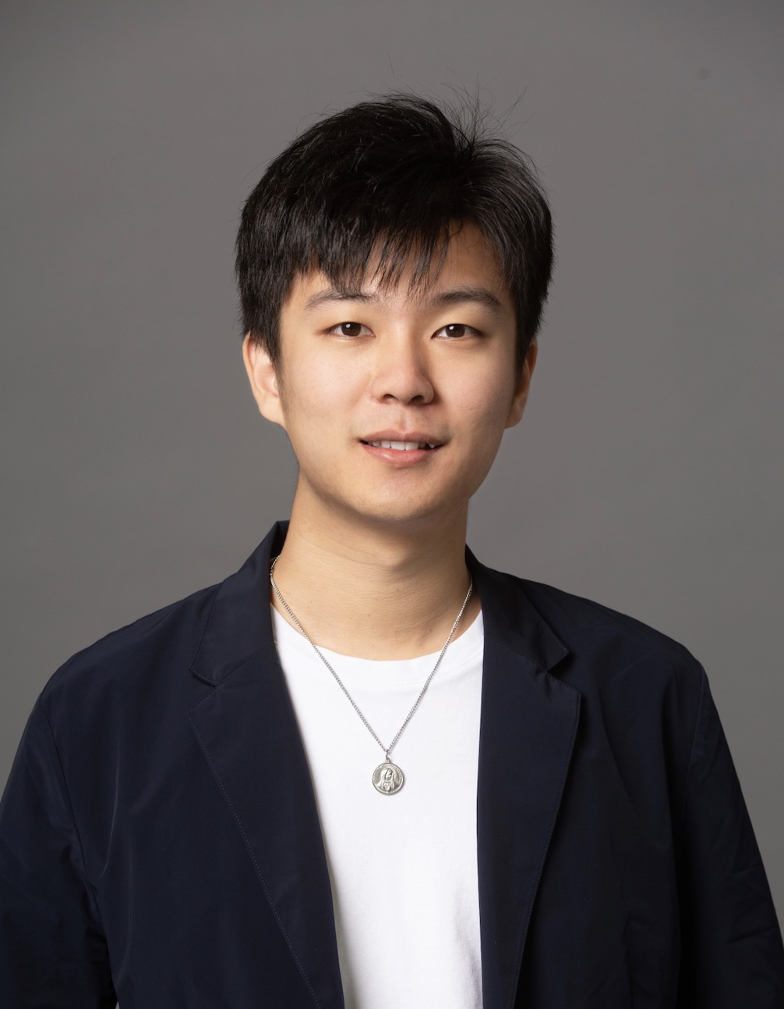
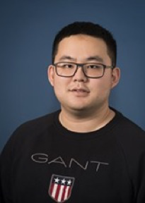
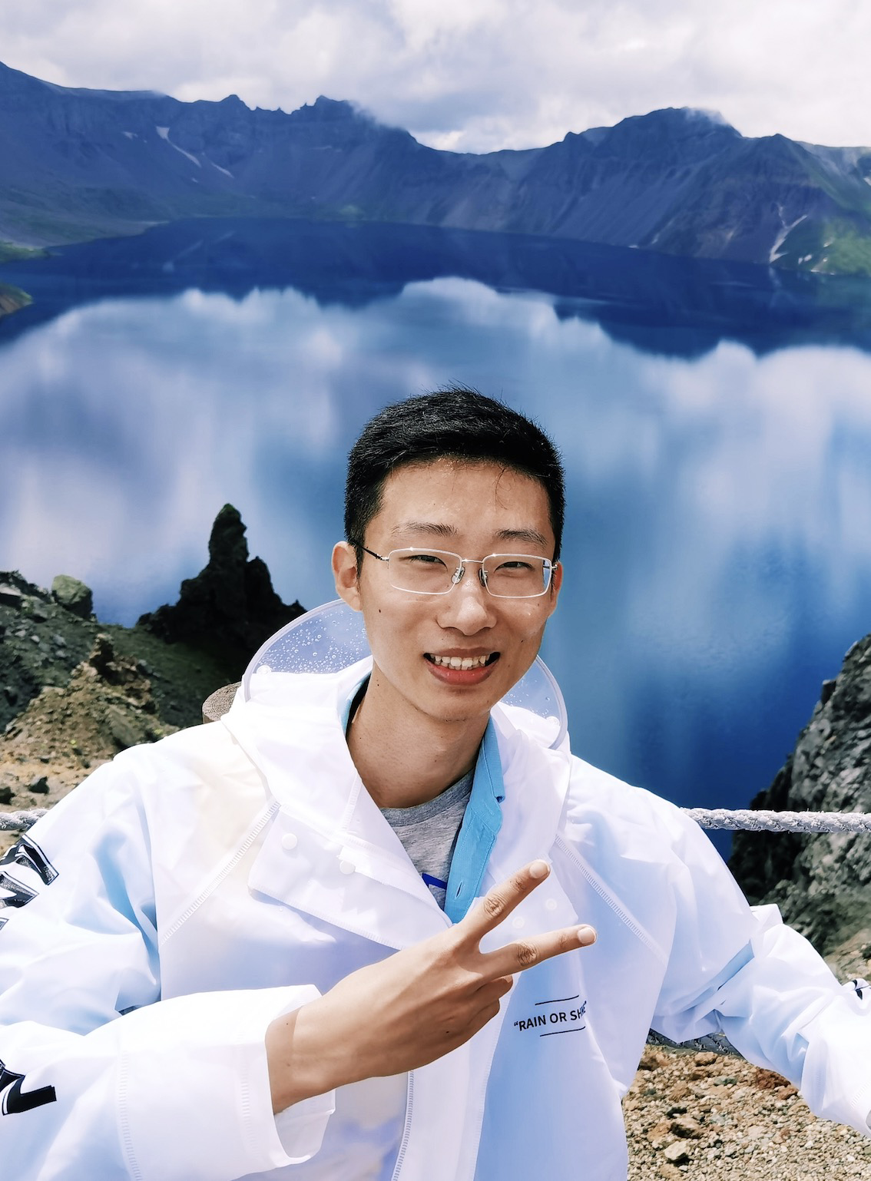
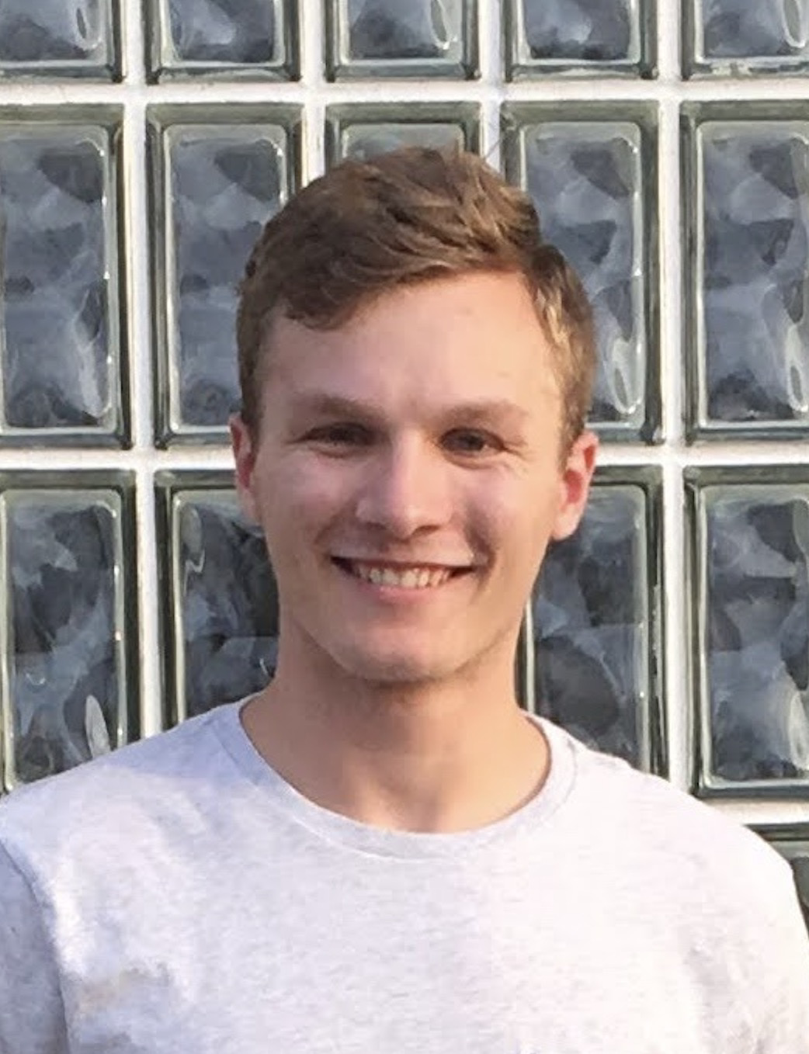
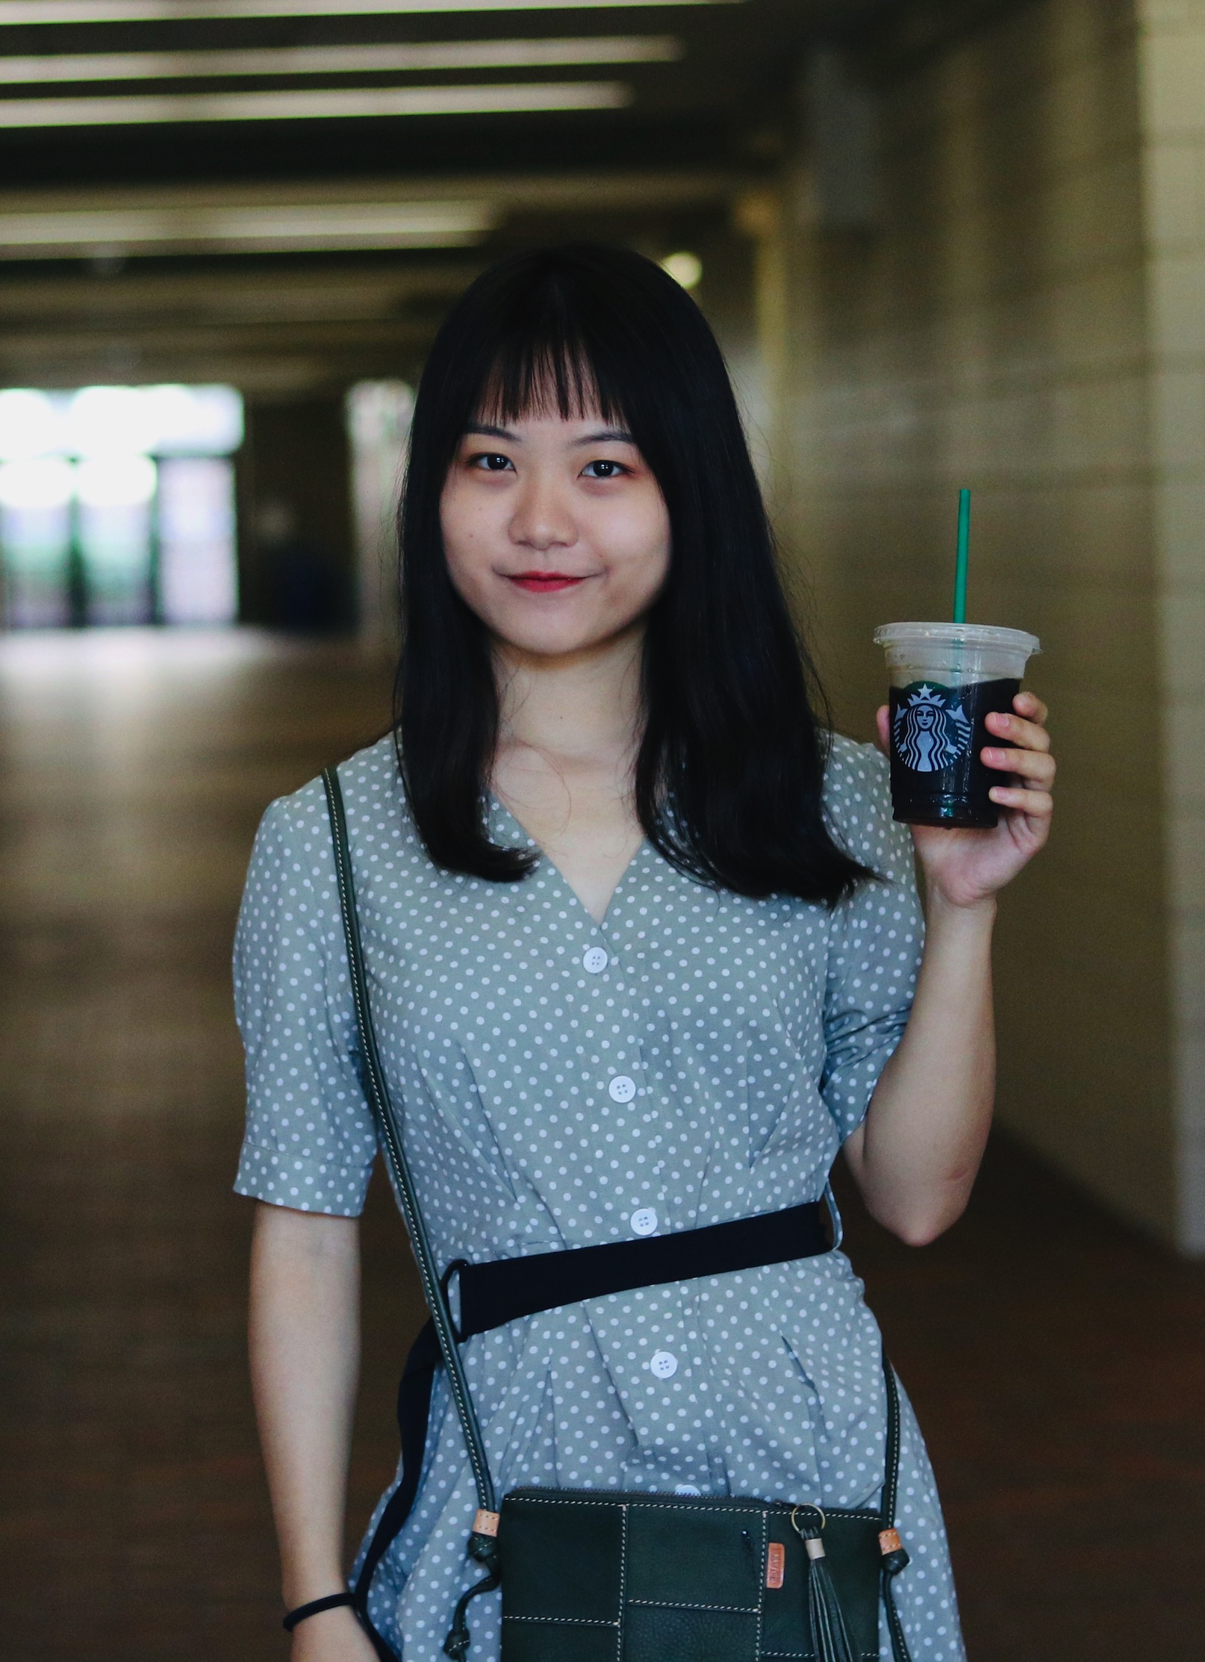
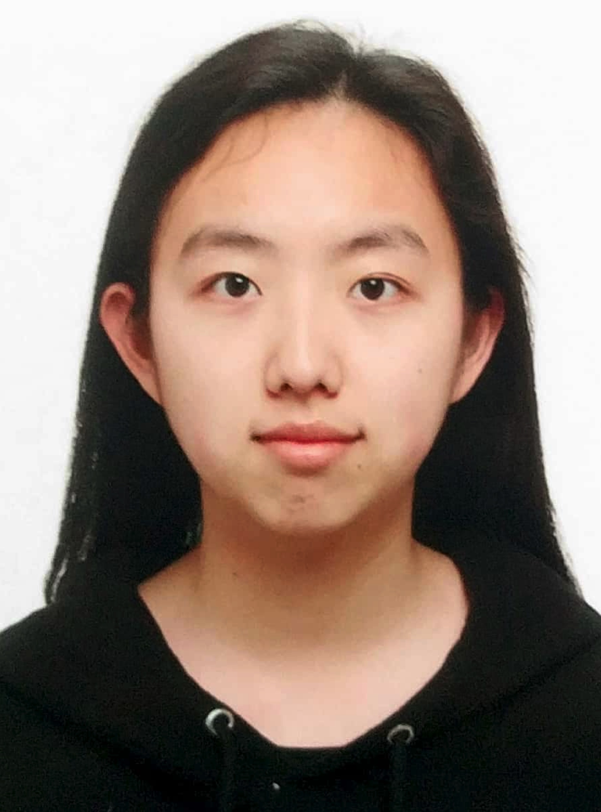

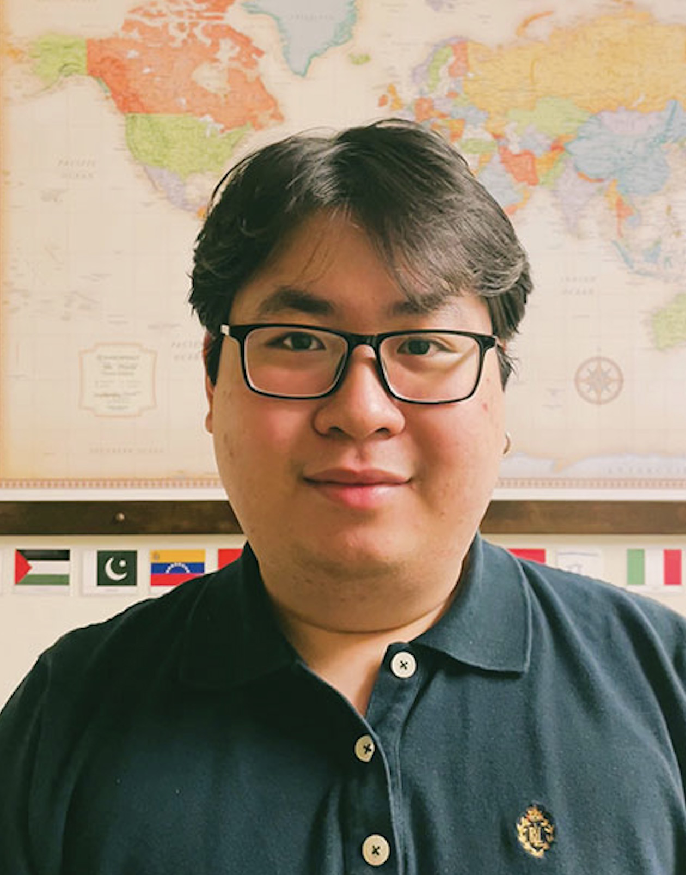
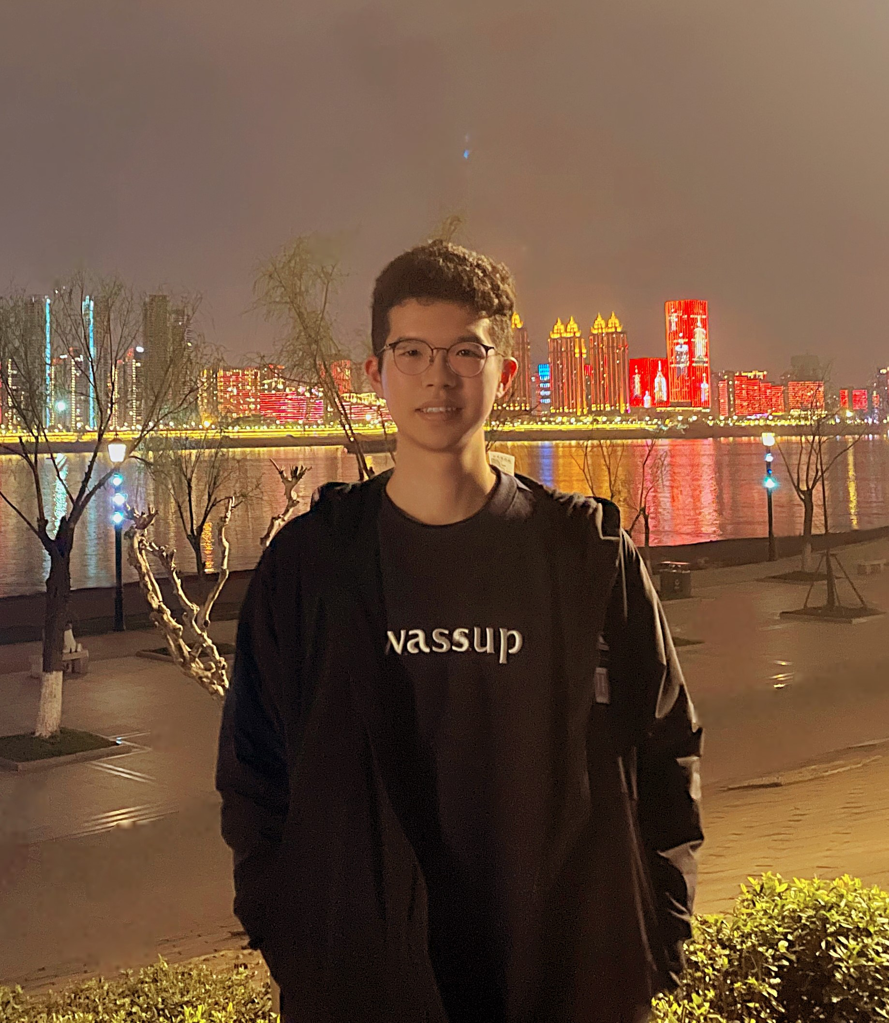
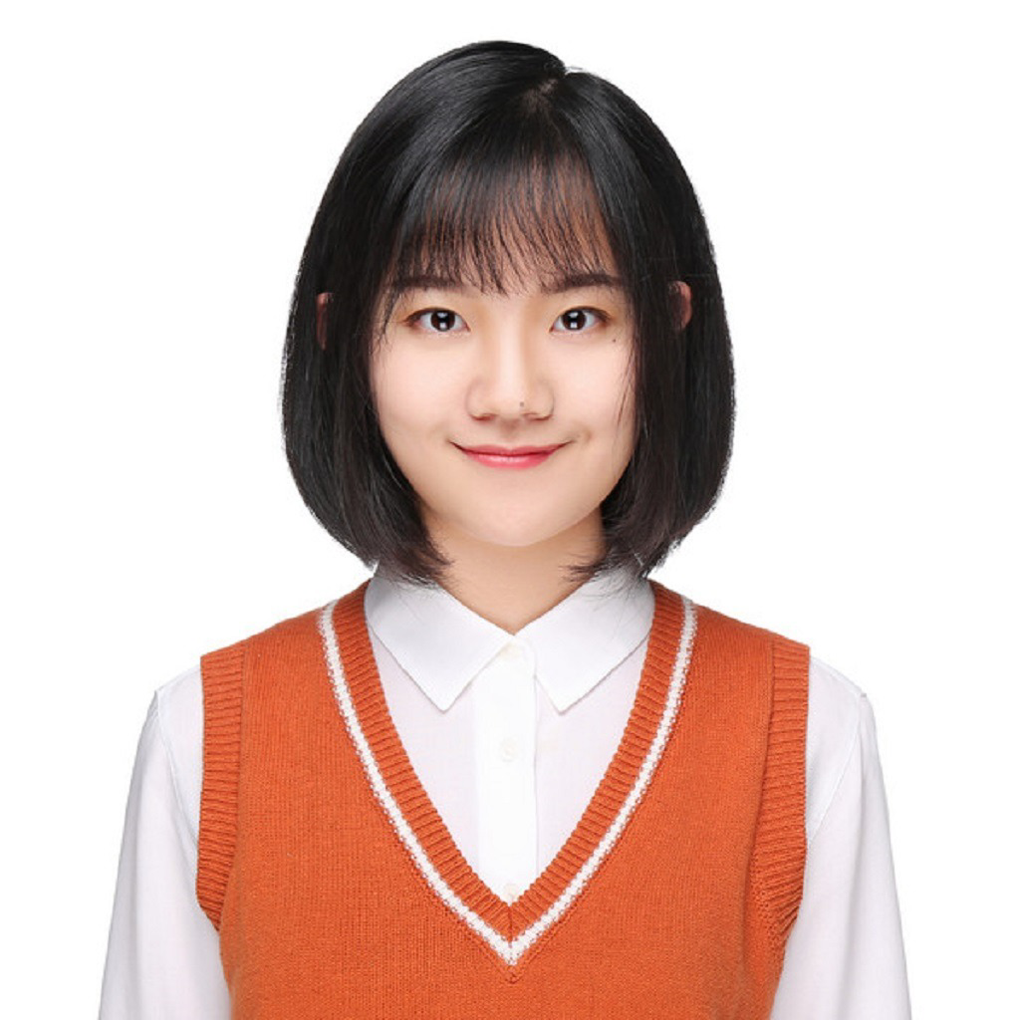
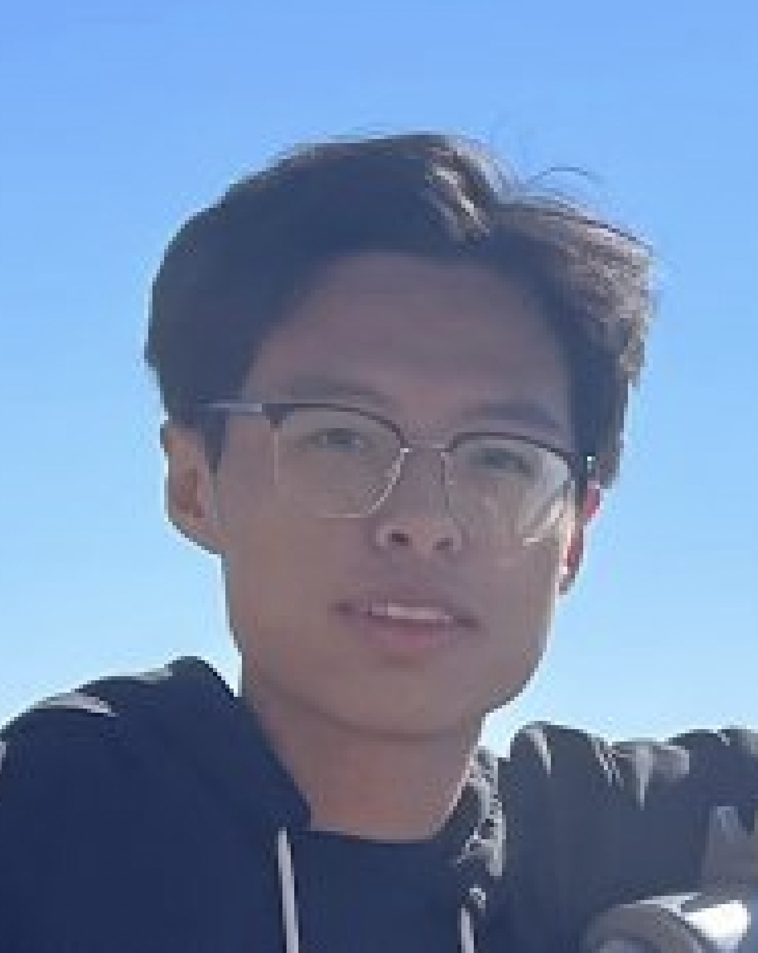
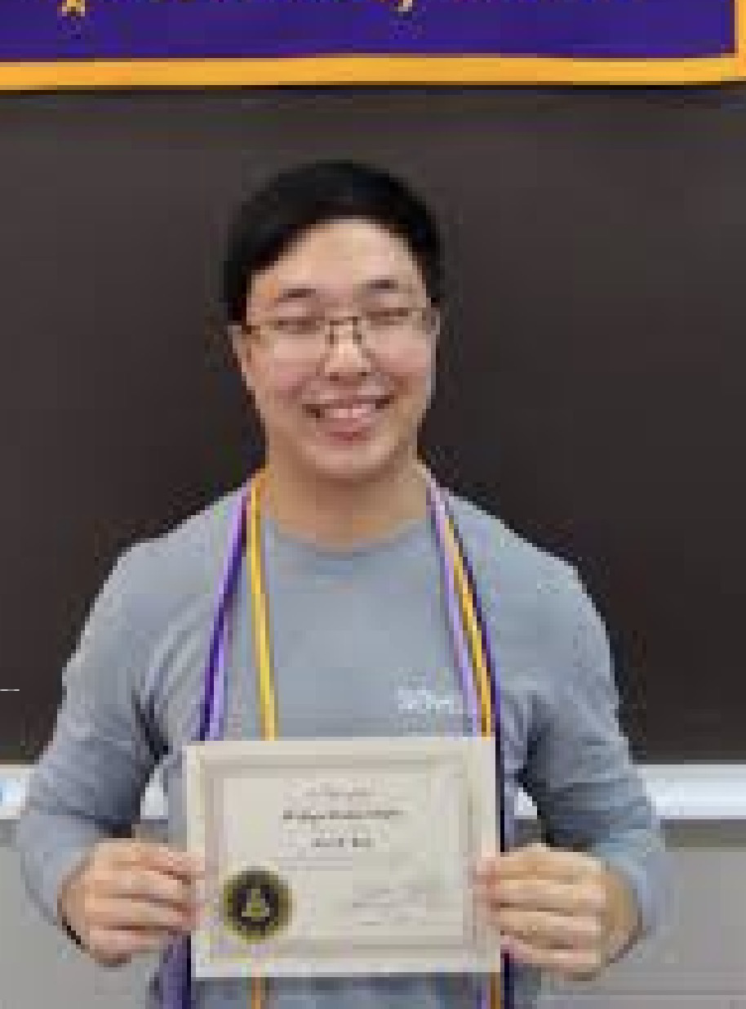
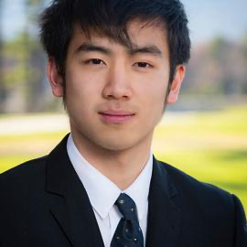
Meng Jiang
Associate Professor
Wenhao Yu 于文豪
Bloomberg Fellowship
ICLR’23, EMNLP’22 * 2, ACL’22 * 2,
EMNLP’21 * 2, NAACL’21, WWW’20 * 2
LLM and Open-domain QA
Qingkai Zeng 曾庆锴
KDD’21, EMNLP’20
Information Extraction
Taxonomy Construction
Faculty
PhD Cand.
Zhihan Zhang 张智涵
TACL’23, EMNLP’22
LLM and Open-domain QA
Instruction Tuning
Noah Ziems 诺阿
ACL’23
LLM and Open-domain QA
Controlled Text Generation
Mengxia Yu 虞梦夏
CSE Select Fellowship
LLM for Education
Comparative Reasoning
PhD Student
Lingbo Tong 仝凌波
Psychology-CSE Joint PhD
LLM for Mental Health
Knowledge Graph
Hy Dang 邓熙
LLM for Mental Health
Query Expansion
Bang Nguyen 阮邦
LLM for Education
Query/Question Generation
Zhaoxuan Tan 谭兆轩
LLM for User Modeling
Mengzhao Jia
贾梦朝
LLM for User Modeling
Eric Inae
Dean’s Fellowship
Zheyuan Liu 刘哲源
Gang Liu 刘罡
KDD’22, KDD’23
GNN for Material Science

Slide 29

Welcome to visit our lab!
http://www.meng-jiang.com/lab.html
https://github.com/DM2-ND
mjiang2@nd.edu
28

